Slide 1
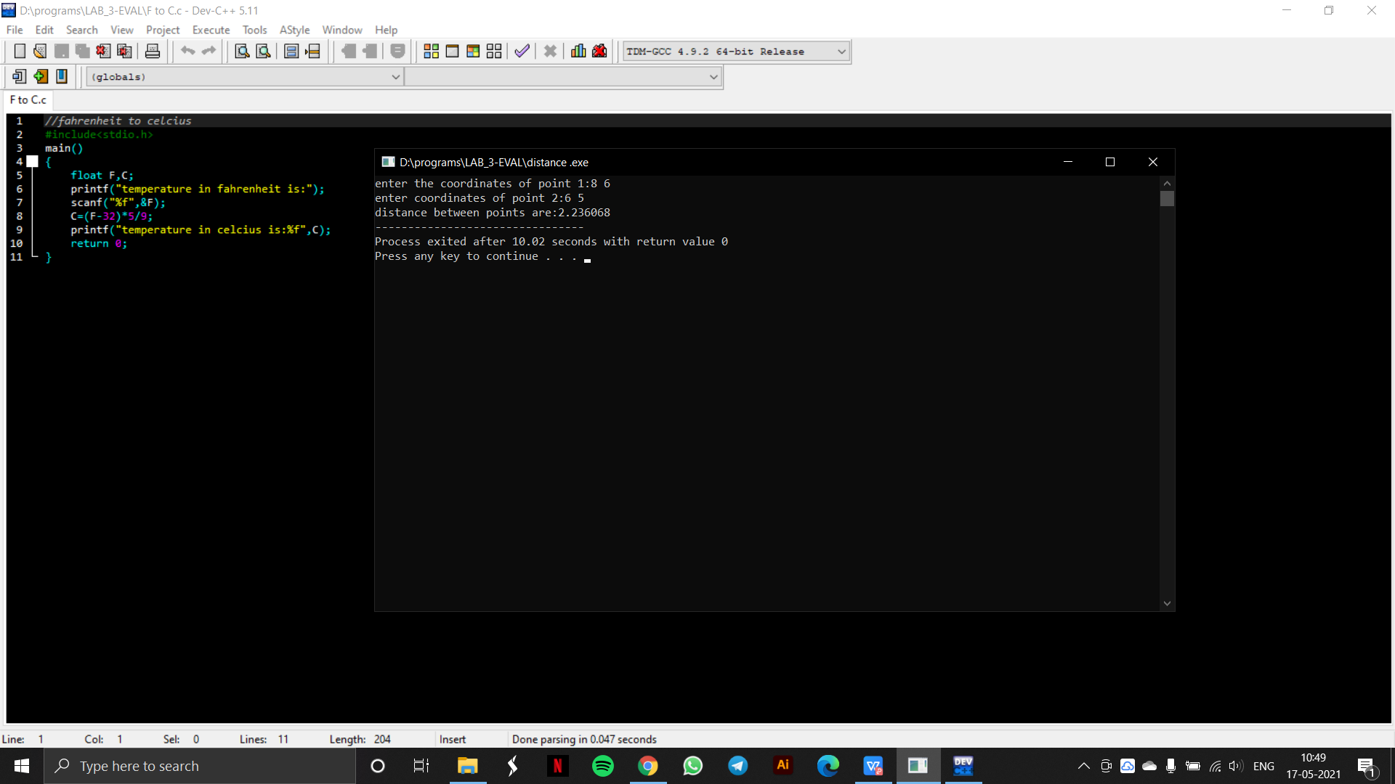
OUTPUT OF PROGRAM 1- FAHRENHEIT TO CELCIUS

Slide 2
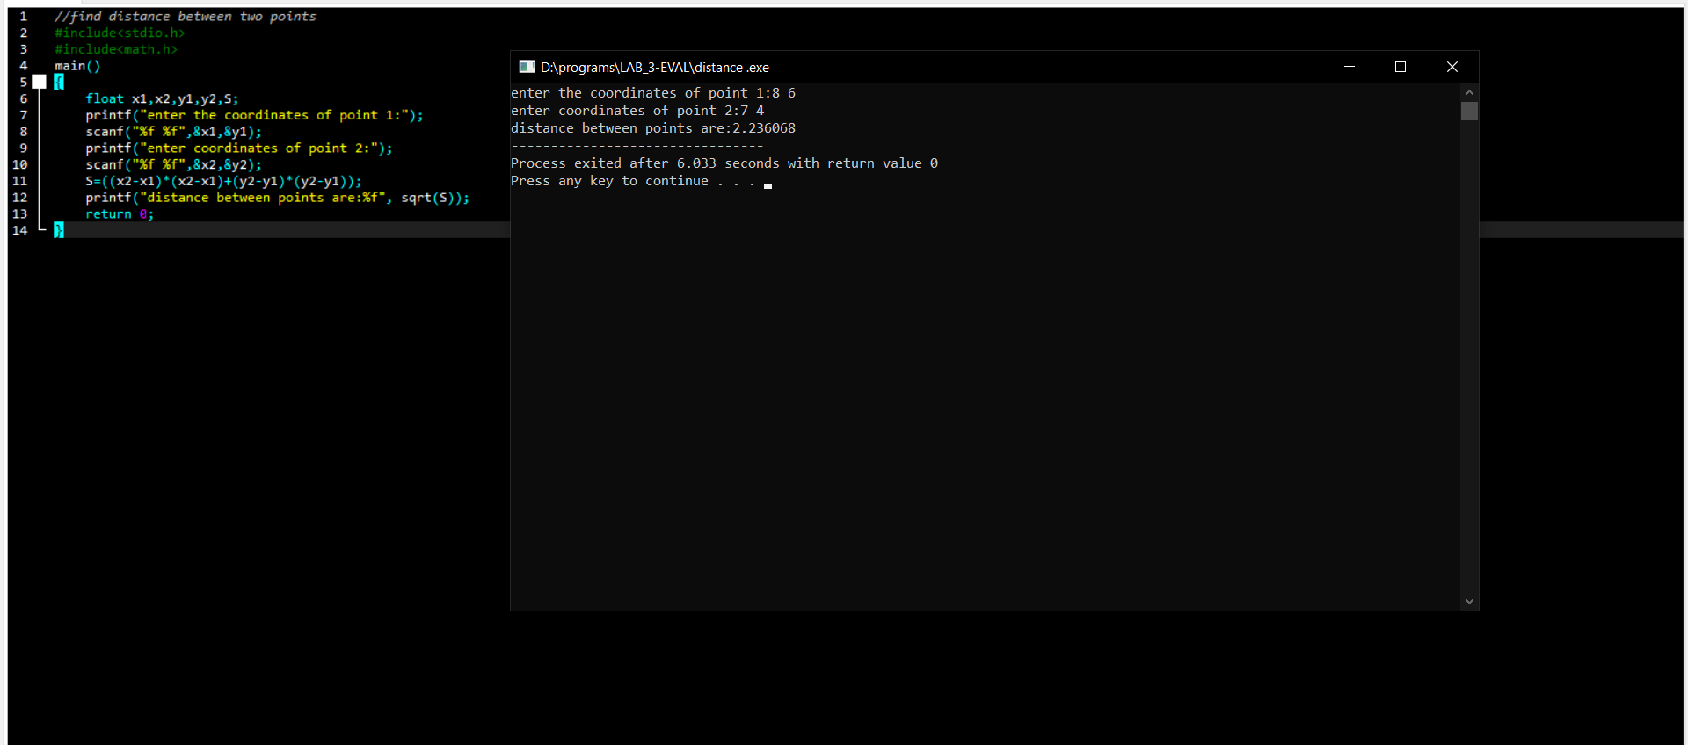
OUTPUT OF PROGRAM 2- DISTANCE BETWEEN TWO POINTS

